Slide 1
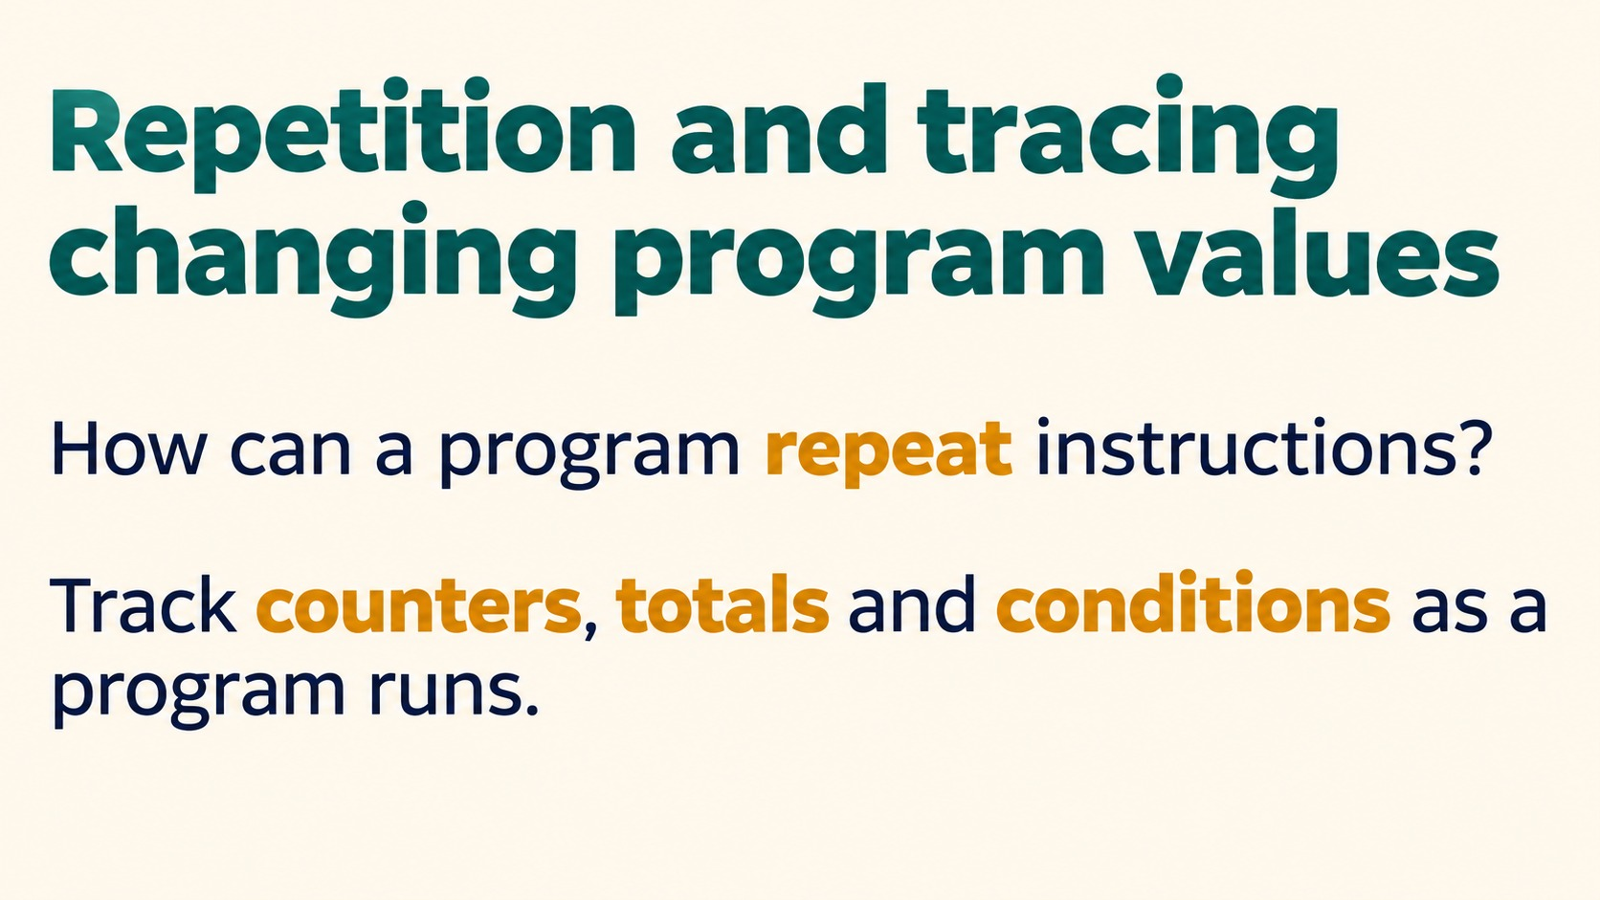
Notes:
Repetition and tracing changing program values
How can a program repeat instructions?
Track counters, totals and conditions as a program runs.
Source: Pearson Edexcel International GCSE (9-1) Computer Science, Unit 2, Develop Code, printed pages 42-48. Teaching examples adapted for Python. Slide artwork generated with OpenAI image generation.

Slide 2
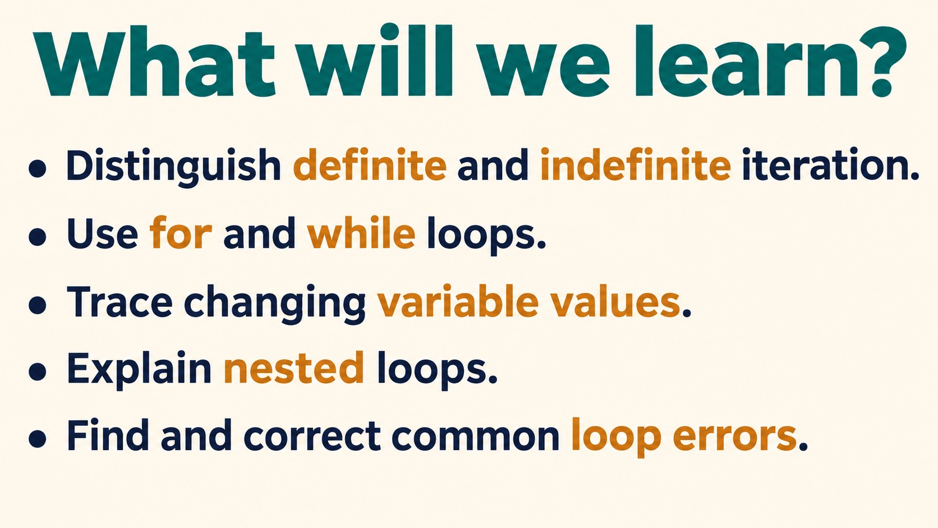
Notes:
What will we learn?
Distinguish definite and indefinite iteration.
Use for and while loops.
Trace changing variable values.
Explain nested loops.
Find and correct common loop errors.
Source: Pearson Edexcel International GCSE (9-1) Computer Science, Unit 2, Develop Code, printed pages 42-48. Teaching examples adapted for Python. Slide artwork generated with OpenAI image generation.

Slide 3
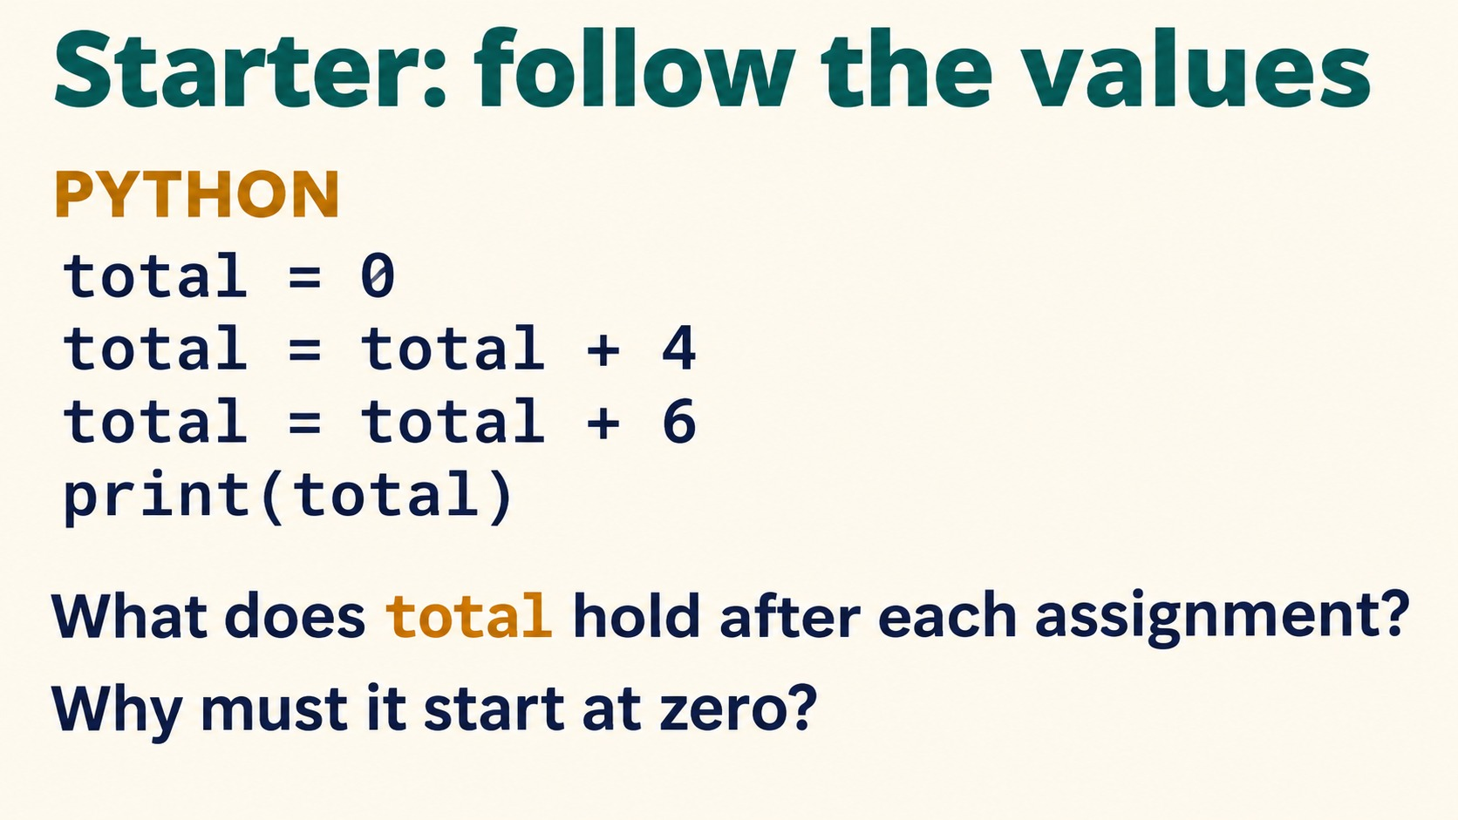
Notes:
Starter: follow the values
PYTHON
total = 0
total = total + 4
total = total + 6
print(total)
What does total hold after each assignment?
Why must it start at zero?
Values: 0, 4, 10. Output: 10. Initialise the running total before adding values.
Source: Pearson Edexcel International GCSE (9-1) Computer Science, Unit 2, Develop Code, printed pages 42-48. Teaching examples adapted for Python. Slide artwork generated with OpenAI image generation.

Slide 4
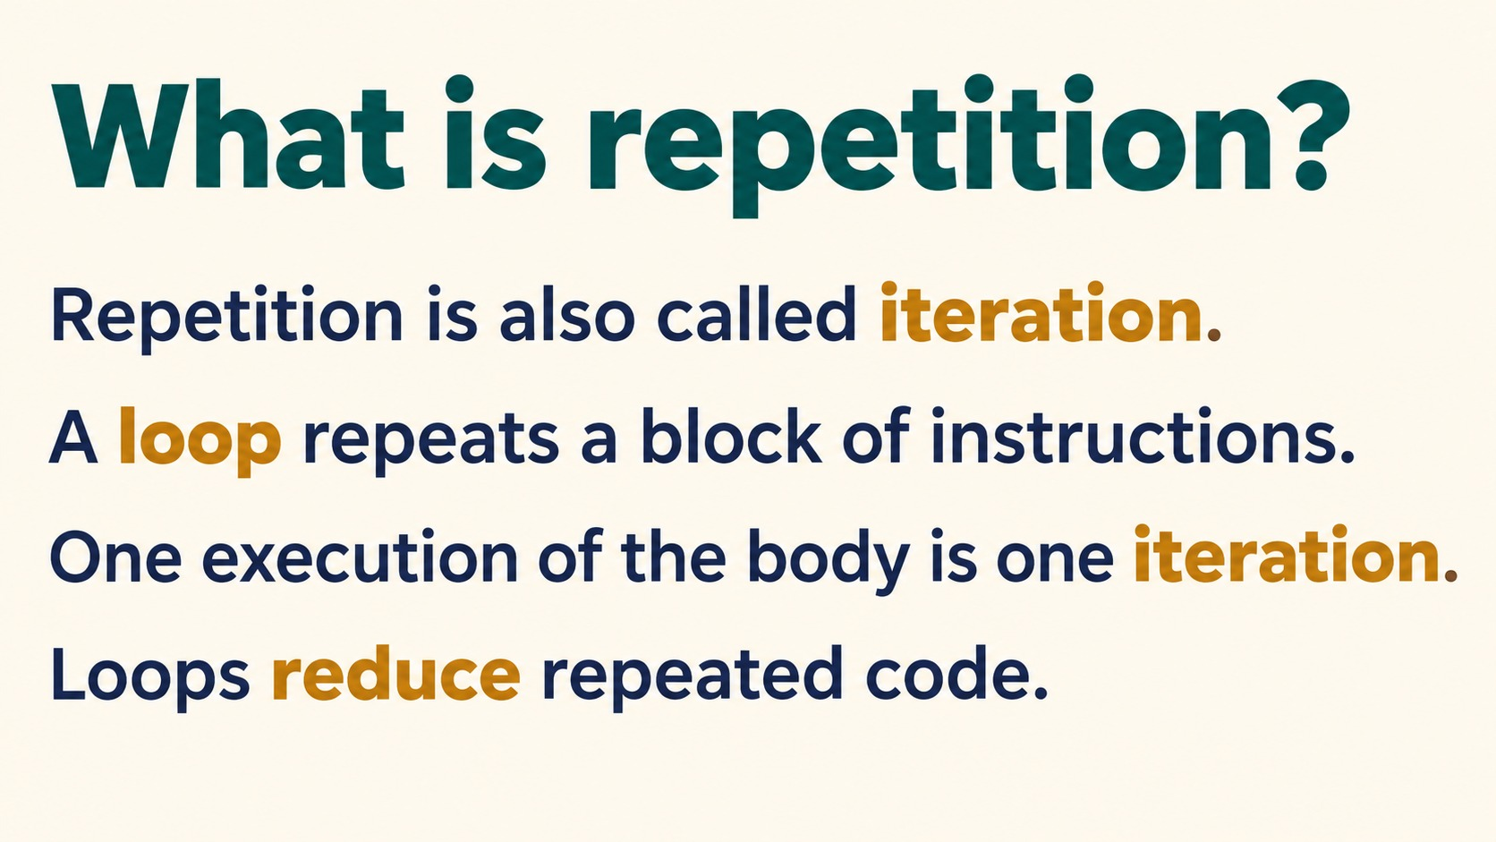
Notes:
What is repetition?
Repetition is also called iteration.
A loop repeats a block of instructions.
One execution of the body is one iteration.
Loops reduce repeated code.
Source: Pearson Edexcel International GCSE (9-1) Computer Science, Unit 2, Develop Code, printed pages 42-48. Teaching examples adapted for Python. Slide artwork generated with OpenAI image generation.

Slide 5
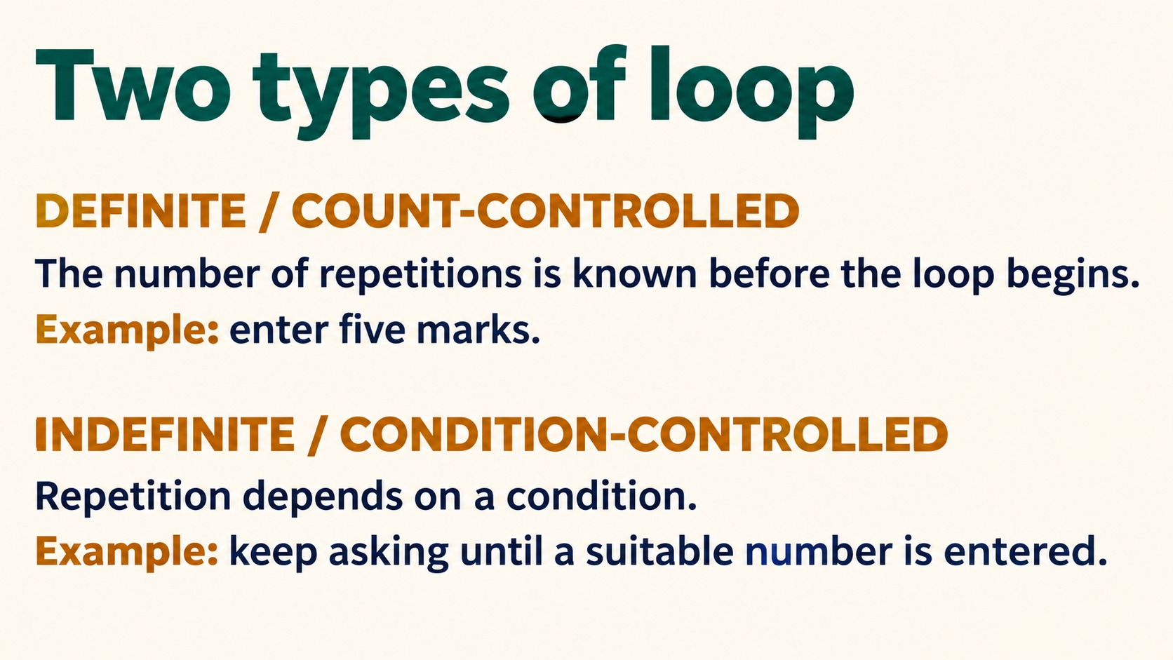
Notes:
Two types of loop
DEFINITE / COUNT-CONTROLLED
The number of repetitions is known before the loop begins.
Example: enter five marks.
INDEFINITE / CONDITION-CONTROLLED
Repetition depends on a condition.
Example: keep asking until a suitable number is entered.
Source: Pearson Edexcel International GCSE (9-1) Computer Science, Unit 2, Develop Code, printed pages 42-48. Teaching examples adapted for Python. Slide artwork generated with OpenAI image generation.

Slide 6
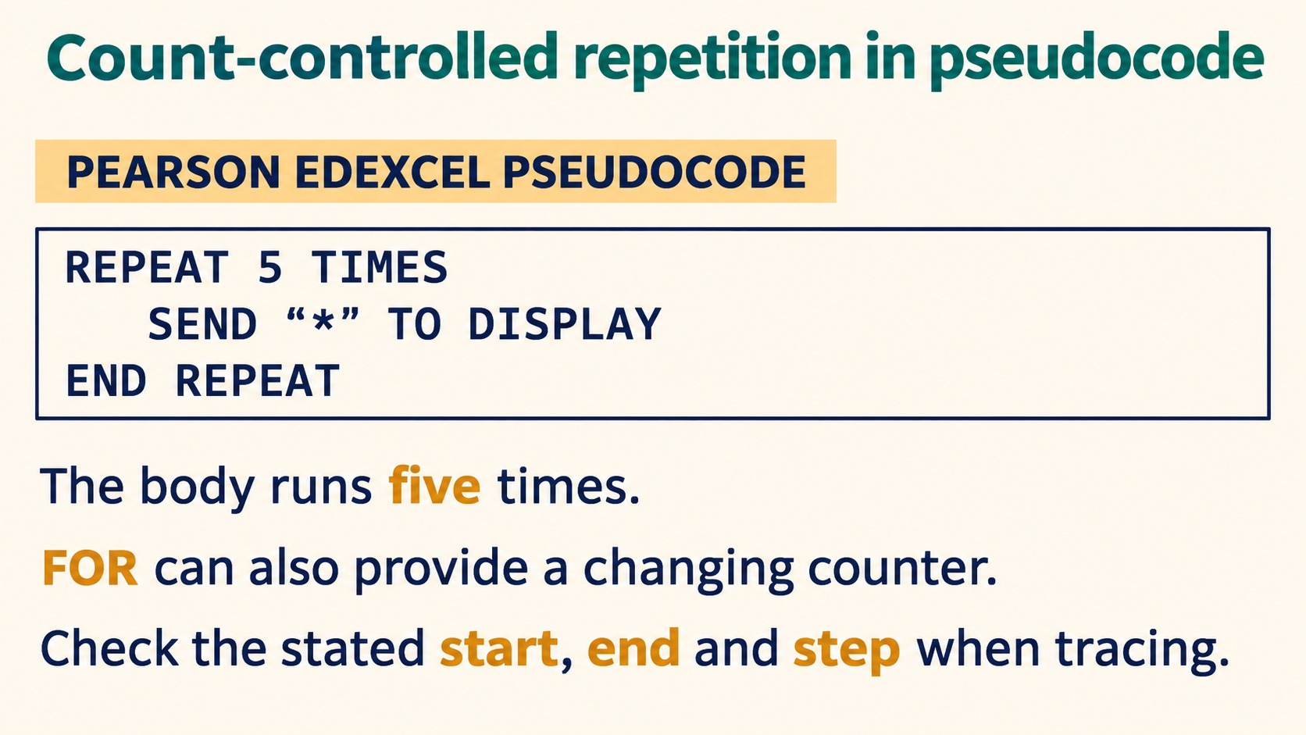
Notes:
Count-controlled repetition in pseudocode
PEARSON EDEXCEL PSEUDOCODE
REPEAT 5 TIMES
SEND "*" TO DISPLAY
END REPEAT
The body runs five times.
FOR can also provide a changing counter.
Check the stated start, end and step when tracing.
Source: Pearson Edexcel International GCSE (9-1) Computer Science, Unit 2, Develop Code, printed pages 42-48. Teaching examples adapted for Python. Slide artwork generated with OpenAI image generation.

Slide 7
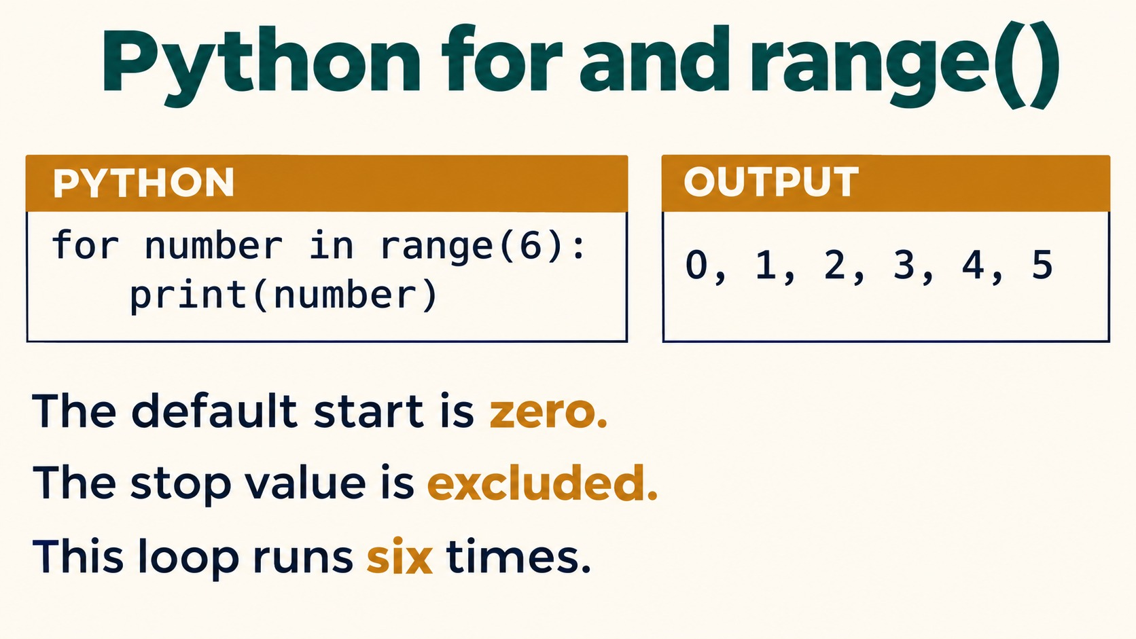
Notes:
Python for and range()
PYTHON
for number in range(6):
print(number)
OUTPUT
0, 1, 2, 3, 4, 5
The default start is zero.
The stop value is excluded.
This loop runs six times.
The output values print on separate lines.
Source: Pearson Edexcel International GCSE (9-1) Computer Science, Unit 2, Develop Code, printed pages 42-48. Teaching examples adapted for Python. Slide artwork generated with OpenAI image generation.

Slide 8
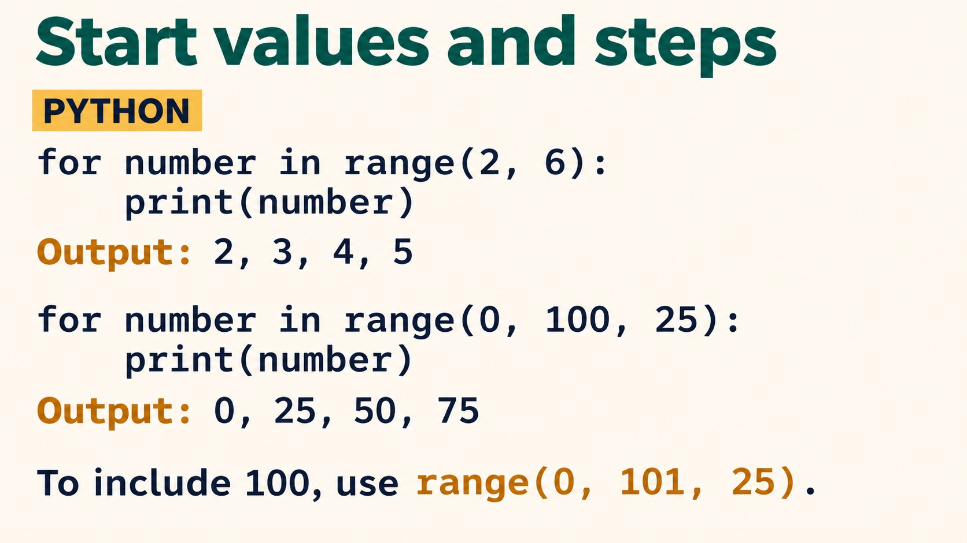
Notes:
Start values and steps
PYTHON
for number in range(2, 6):
print(number)
Output: 2, 3, 4, 5
for number in range(0, 100, 25):
print(number)
Output: 0, 25, 50, 75
To include 100, use range(0, 101, 25).
Output listings use commas for compact display; print emits separate lines.
Source: Pearson Edexcel International GCSE (9-1) Computer Science, Unit 2, Develop Code, printed pages 42-48. Teaching examples adapted for Python. Slide artwork generated with OpenAI image generation.

Slide 9
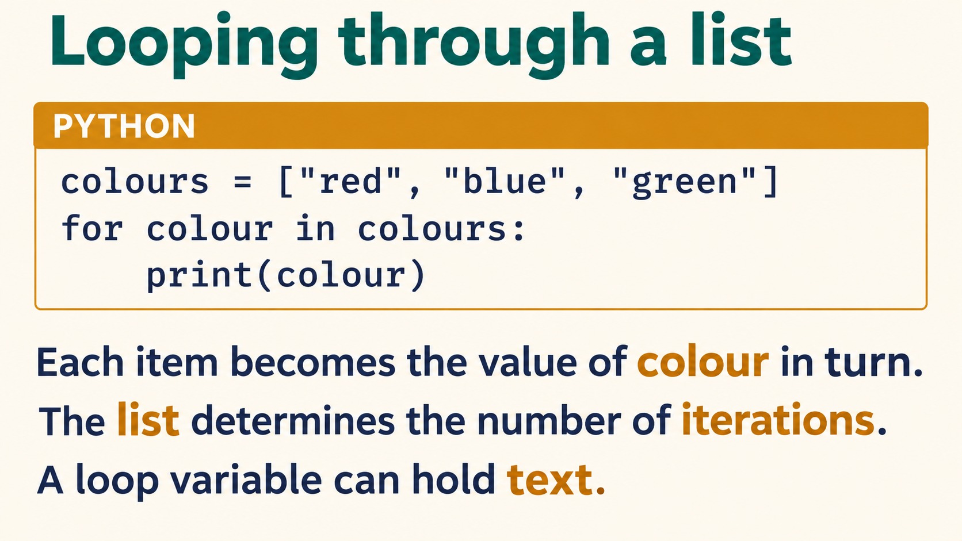
Notes:
Looping through a list
PYTHON
colours = ["red", "blue", "green"]
for colour in colours:
print(colour)
Each item becomes the value of colour in turn.
The list determines the number of iterations.
A loop variable can hold text.
Source: Pearson Edexcel International GCSE (9-1) Computer Science, Unit 2, Develop Code, printed pages 42-48. Teaching examples adapted for Python. Slide artwork generated with OpenAI image generation.

Slide 10
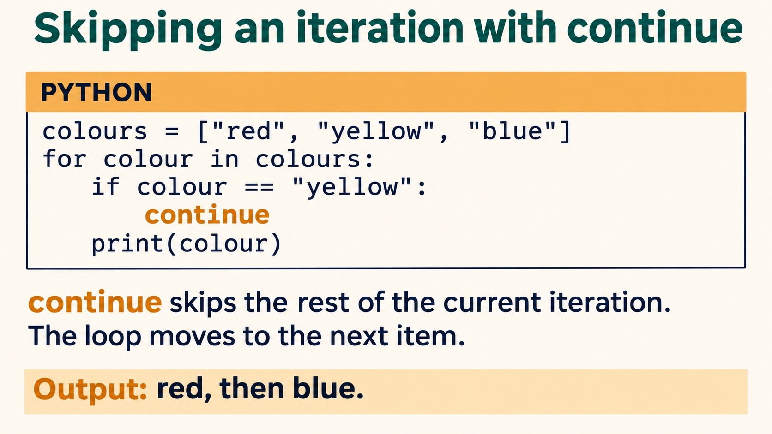
Notes:
Skipping an iteration with continue
PYTHON
colours = ["red", "yellow", "blue"]
for colour in colours:
if colour == "yellow":
continue
print(colour)
continue skips the rest of the current iteration.
The loop moves to the next item.
Output: red, then blue.
Source: Pearson Edexcel International GCSE (9-1) Computer Science, Unit 2, Develop Code, printed pages 42-48. Teaching examples adapted for Python. Slide artwork generated with OpenAI image generation.

Slide 11
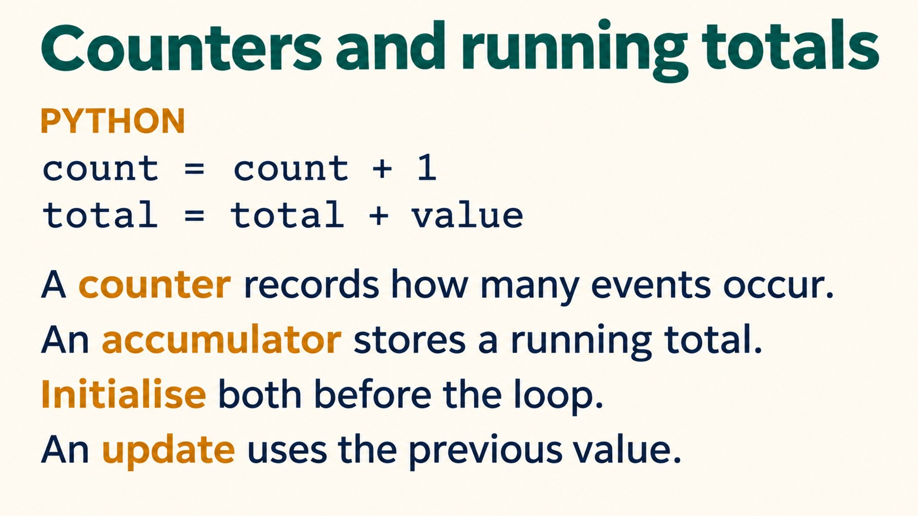
Notes:
Counters and running totals
PYTHON
count = count + 1
total = total + value
A counter records how many events occur.
An accumulator stores a running total.
Initialise both before the loop.
An update uses the previous value.
These are update statements, assuming count, total and value already have numeric values.
Source: Pearson Edexcel International GCSE (9-1) Computer Science, Unit 2, Develop Code, printed pages 42-48. Teaching examples adapted for Python. Slide artwork generated with OpenAI image generation.

Slide 12
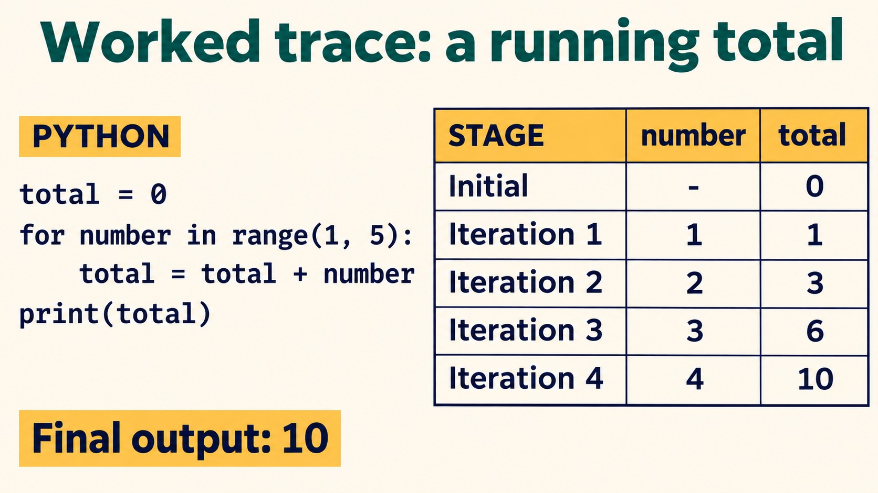
Notes:
Worked trace: a running total
PYTHON
total = 0
for number in range(1, 5):
total = total + number
print(total)
STAGE number total
Initial - 0
Iteration 1 1 1
Iteration 2 2 3
Iteration 3 3 6
Iteration 4 4 10
Final output: 10
Source: Pearson Edexcel International GCSE (9-1) Computer Science, Unit 2, Develop Code, printed pages 42-48. Teaching examples adapted for Python. Slide artwork generated with OpenAI image generation.

Slide 13
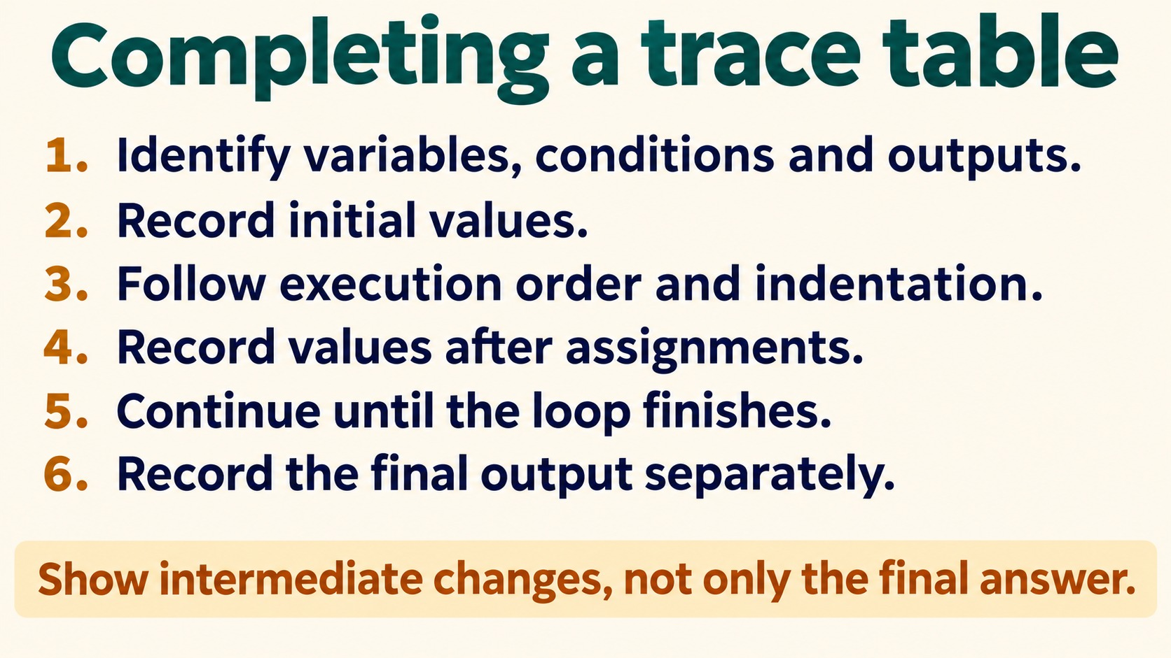
Notes:
Completing a trace table
1. Identify variables, conditions and outputs.
2. Record initial values.
3. Follow execution order and indentation.
4. Record values after assignments.
5. Continue until the loop finishes.
6. Record the final output separately.
Show intermediate changes, not only the final answer.
Source: Pearson Edexcel International GCSE (9-1) Computer Science, Unit 2, Develop Code, printed pages 42-48. Teaching examples adapted for Python. Slide artwork generated with OpenAI image generation.

Slide 14
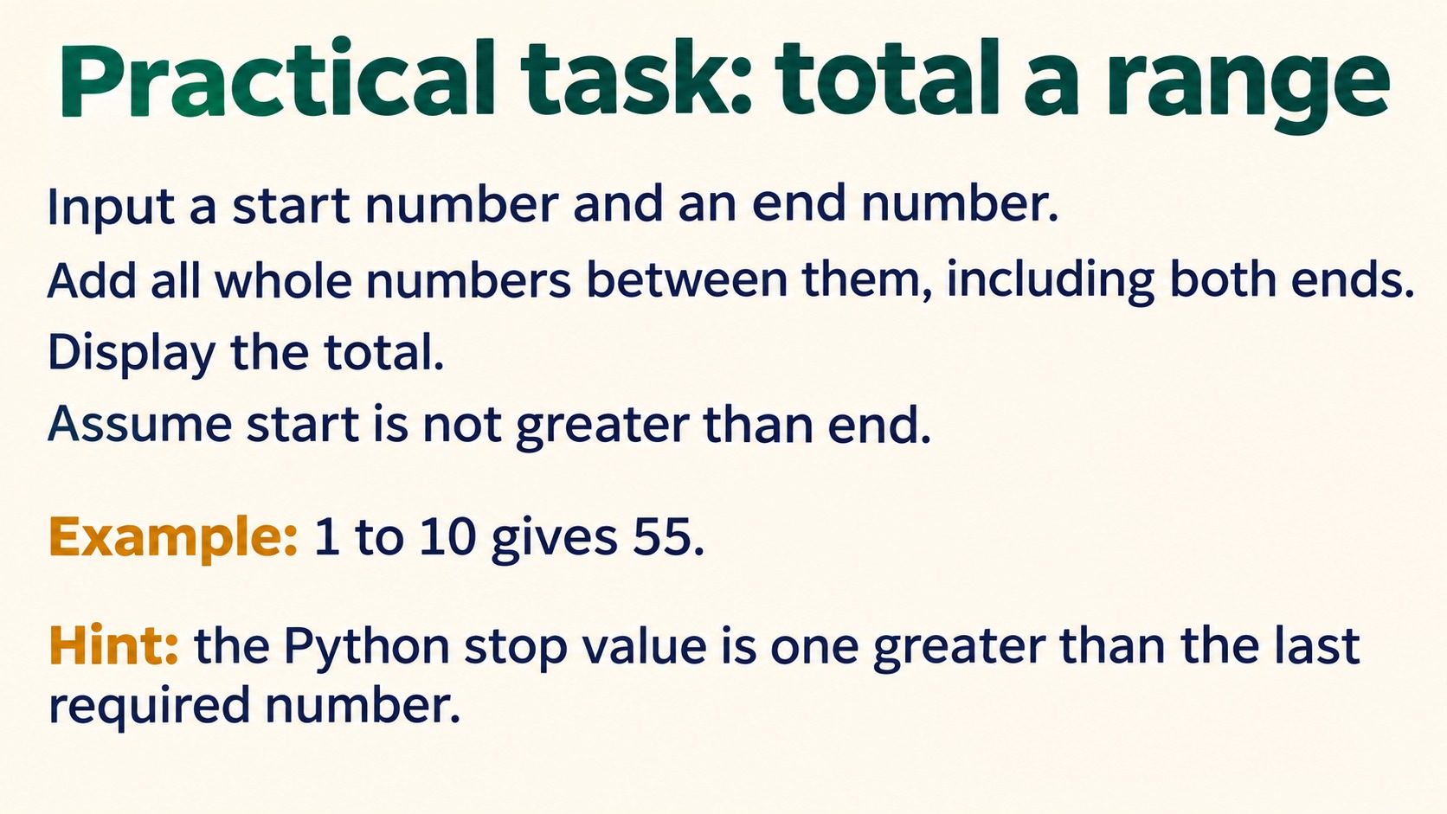
Notes:
Practical task: total a range
Input a start number and an end number.
Add all whole numbers between them, including both ends.
Display the total.
Assume start is not greater than end.
Example: 1 to 10 gives 55.
Hint: the Python stop value is one greater than the last required number.
Solution: total = 0; for number in range(start, end + 1): total = total + number; print(total).
Source: Pearson Edexcel International GCSE (9-1) Computer Science, Unit 2, Develop Code, printed pages 42-48. Teaching examples adapted for Python. Slide artwork generated with OpenAI image generation.

Slide 15
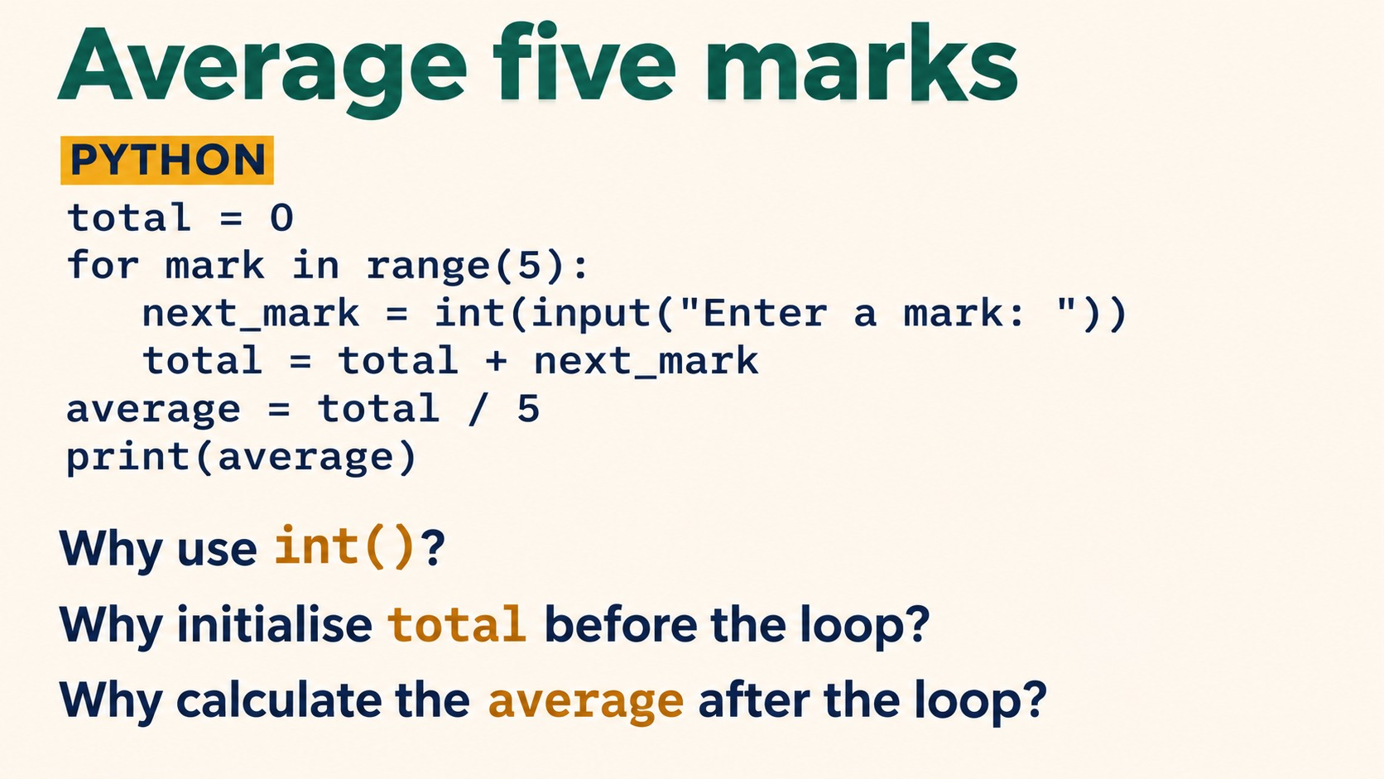
Notes:
Average five marks
PYTHON
total = 0
for mark in range(5):
next_mark = int(input("Enter a mark: "))
total = total + next_mark
average = total / 5
print(average)
Why use int()?
Why initialise total before the loop?
Why calculate the average after the loop?
int converts input text to a whole number. Initialisation prevents an undefined running total. Final calculation uses all five marks. Test 2,4,6,8,10: average 6.0.
Source: Pearson Edexcel International GCSE (9-1) Computer Science, Unit 2, Develop Code, printed pages 42-48. Teaching examples adapted for Python. Slide artwork generated with OpenAI image generation.

Slide 16
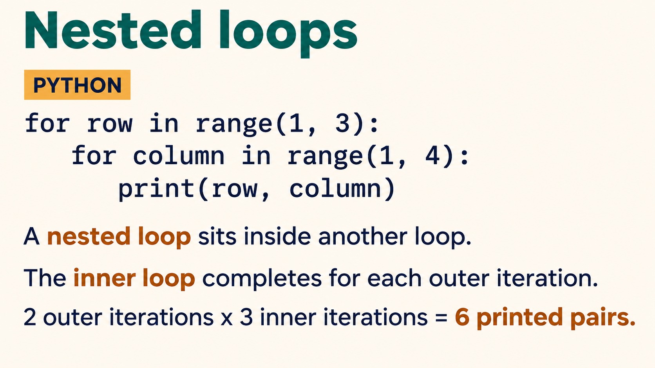
Notes:
Nested loops
PYTHON
for row in range(1, 3):
for column in range(1, 4):
print(row, column)
A nested loop sits inside another loop.
The inner loop completes for each outer iteration.
2 outer iterations x 3 inner iterations = 6 printed pairs.
Pairs: (1,1),(1,2),(1,3),(2,1),(2,2),(2,3).
Source: Pearson Edexcel International GCSE (9-1) Computer Science, Unit 2, Develop Code, printed pages 42-48. Teaching examples adapted for Python. Slide artwork generated with OpenAI image generation.

Slide 17
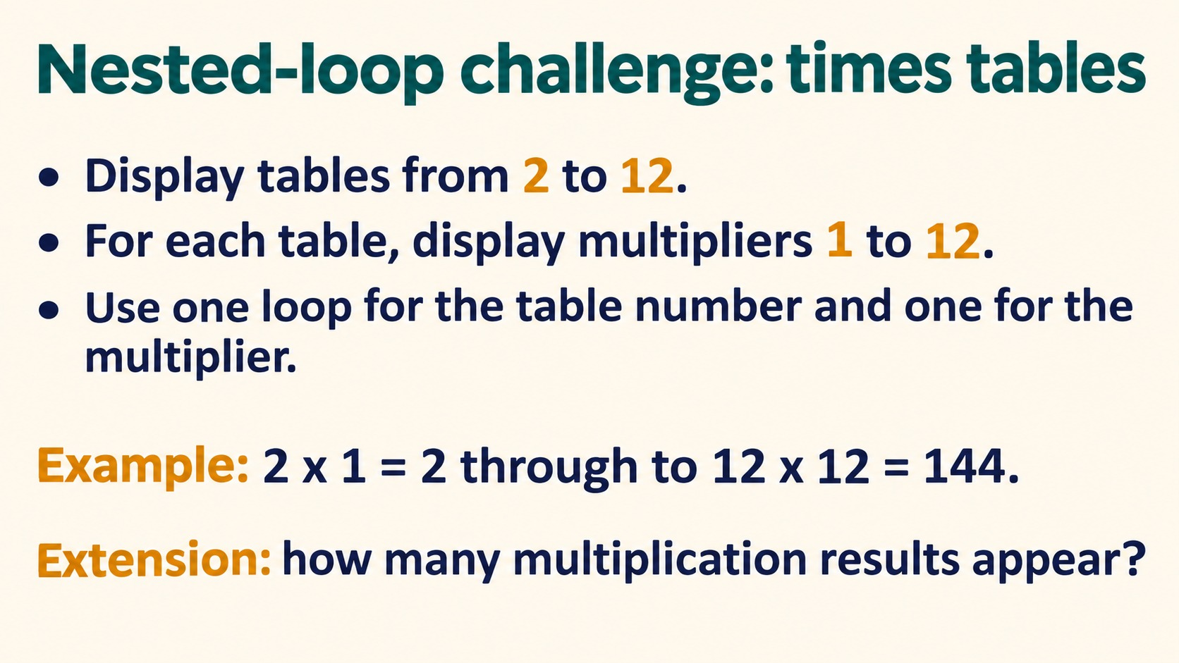
Notes:
Nested-loop challenge: times tables
Display tables from 2 to 12.
For each table, display multipliers 1 to 12.
Use one loop for the table number and one for the multiplier.
Example: 2 x 1 = 2 through to 12 x 12 = 144.
Extension: how many multiplication results appear?
Answer: 11 tables times 12 multipliers = 132 results. Use range(2,13) and range(1,13).
Source: Pearson Edexcel International GCSE (9-1) Computer Science, Unit 2, Develop Code, printed pages 42-48. Teaching examples adapted for Python. Slide artwork generated with OpenAI image generation.

Slide 18
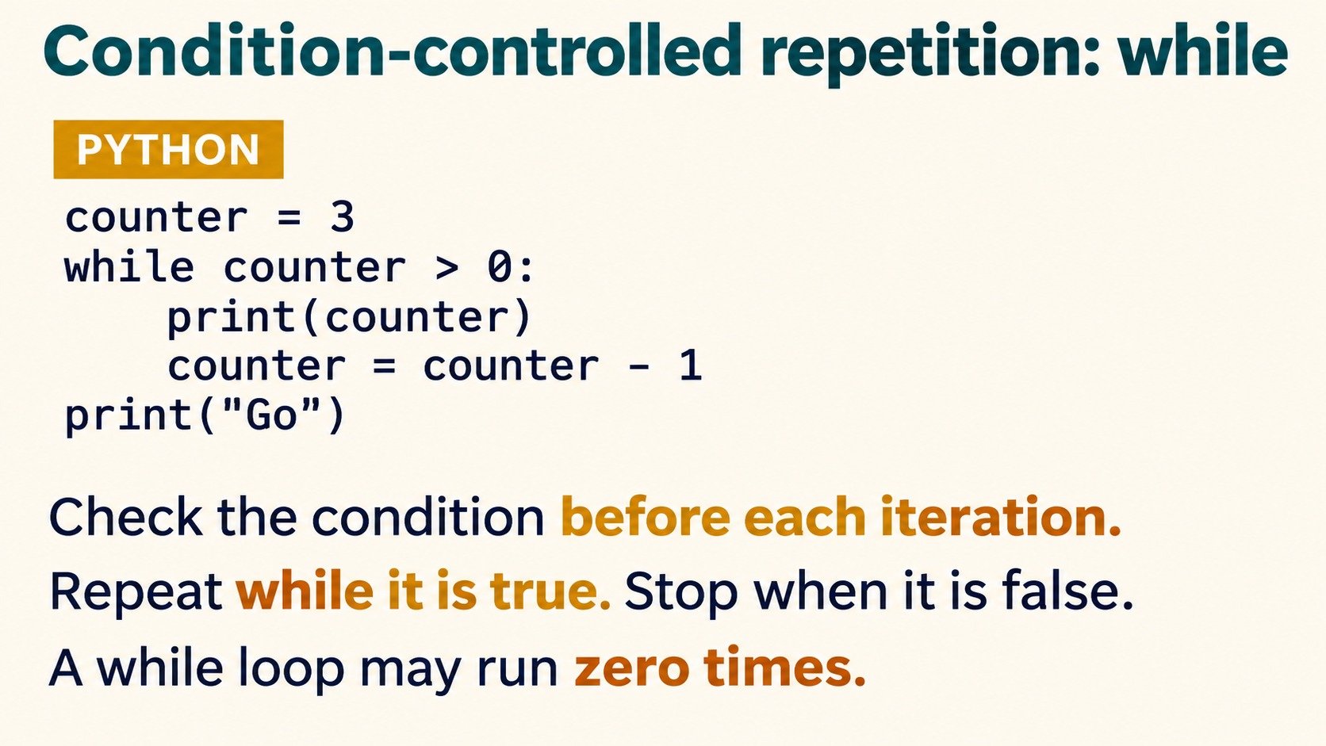
Notes:
Condition-controlled repetition: while
PYTHON
counter = 3
while counter > 0:
print(counter)
counter = counter - 1
print("Go")
Check the condition before each iteration.
Repeat while it is true. Stop when it is false.
A while loop may run zero times.
Source: Pearson Edexcel International GCSE (9-1) Computer Science, Unit 2, Develop Code, printed pages 42-48. Teaching examples adapted for Python. Slide artwork generated with OpenAI image generation.

Slide 19
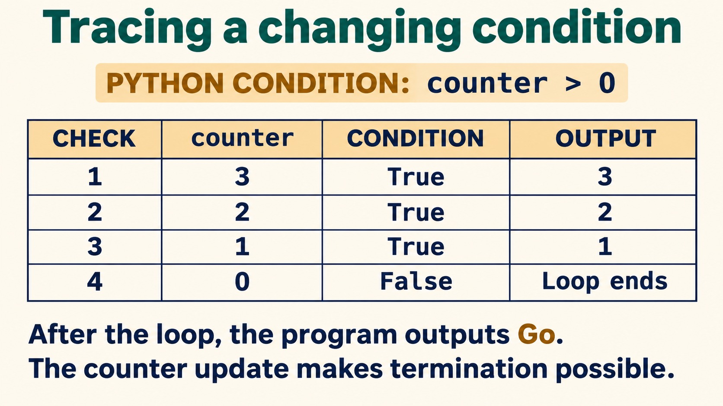
Notes:
Tracing a changing condition
PYTHON CONDITION: counter > 0
CHECK counter CONDITION OUTPUT
1 3 True 3
2 2 True 2
3 1 True 1
4 0 False Loop ends
After the loop, the program outputs Go.
The counter update makes termination possible.
Source: Pearson Edexcel International GCSE (9-1) Computer Science, Unit 2, Develop Code, printed pages 42-48. Teaching examples adapted for Python. Slide artwork generated with OpenAI image generation.

Slide 20
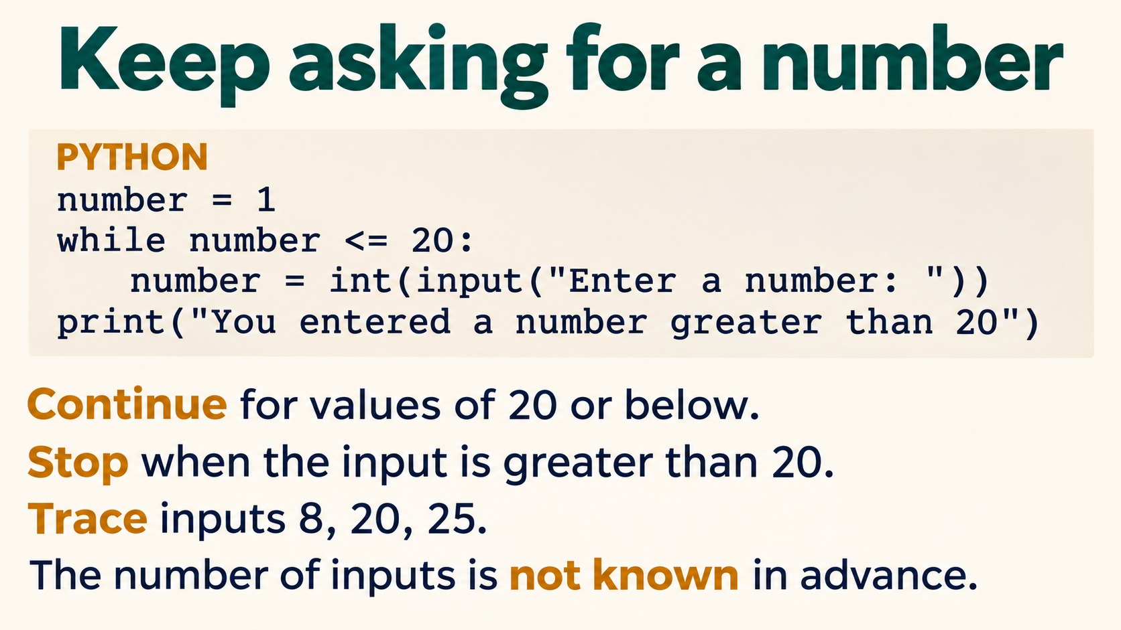
Notes:
Keep asking for a number
PYTHON
number = 1
while number <= 20:
number = int(input("Enter a number: "))
print("You entered a number greater than 20")
Continue for values of 20 or below.
Stop when the input is greater than 20.
Trace inputs 8, 20, 25.
The number of inputs is not known in advance.
Trace checks: initial 1 <=20 True; 8 True; 20 True; 25 False. Three inputs, then the final message.
Source: Pearson Edexcel International GCSE (9-1) Computer Science, Unit 2, Develop Code, printed pages 42-48. Teaching examples adapted for Python. Slide artwork generated with OpenAI image generation.

Slide 21
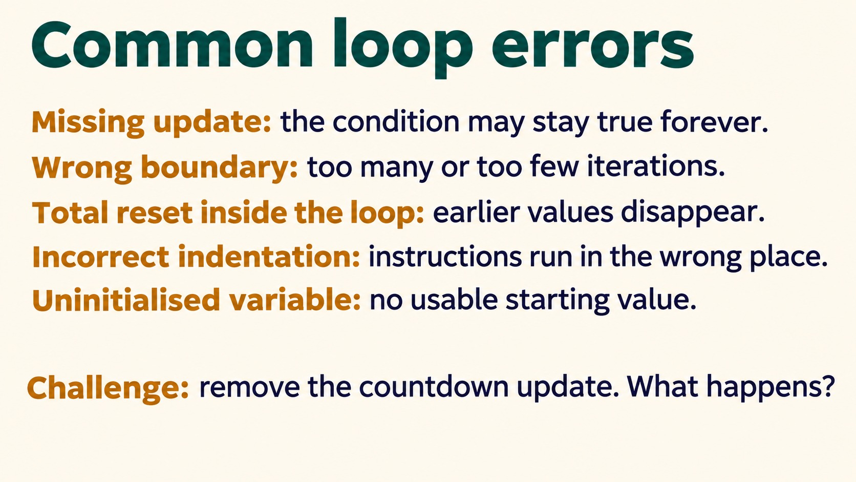
Notes:
Common loop errors
Missing update: the condition may stay true forever.
Wrong boundary: too many or too few iterations.
Total reset inside the loop: earlier values disappear.
Incorrect indentation: instructions run in the wrong place.
Uninitialised variable: no usable starting value.
Challenge: remove the countdown update. What happens?
An unchanged counter of 3 keeps counter > 0 True, so the loop repeatedly prints 3.
Source: Pearson Edexcel International GCSE (9-1) Computer Science, Unit 2, Develop Code, printed pages 42-48. Teaching examples adapted for Python. Slide artwork generated with OpenAI image generation.

Slide 22
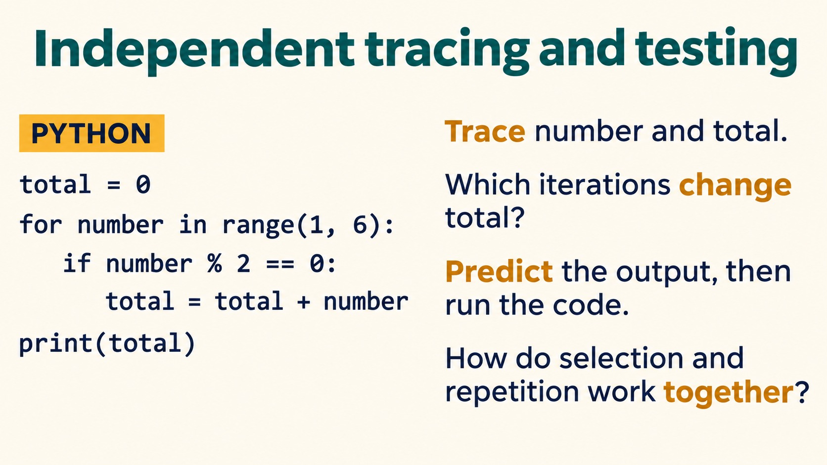
Notes:
Independent tracing and testing
PYTHON
total = 0
for number in range(1, 6):
if number % 2 == 0:
total = total + number
print(total)
Trace number and total.
Which iterations change total?
Predict the output, then run the code.
How do selection and repetition work together?
Total after each iteration: 0,2,2,6,6. Even values 2 and 4 update total. Output 6.
Source: Pearson Edexcel International GCSE (9-1) Computer Science, Unit 2, Develop Code, printed pages 42-48. Teaching examples adapted for Python. Slide artwork generated with OpenAI image generation.

Slide 23
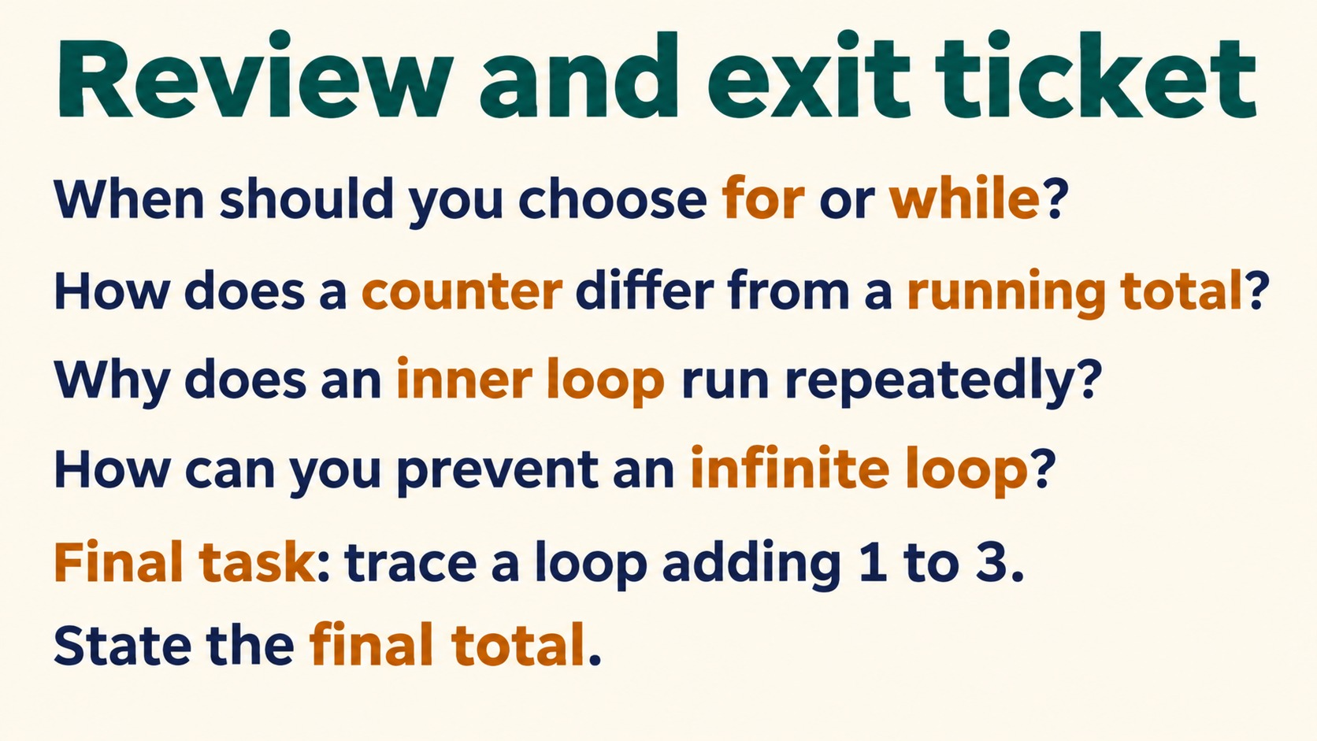
Notes:
Review and exit ticket
When should you choose for or while?
How does a counter differ from a running total?
Why does an inner loop run repeatedly?
How can you prevent an infinite loop?
Final task: trace a loop adding 1 to 3.
State the final total.
Final total 6. Choose for when iterating a known range/list and while when continuation depends on a condition.
Source: Pearson Edexcel International GCSE (9-1) Computer Science, Unit 2, Develop Code, printed pages 42-48. Teaching examples adapted for Python. Slide artwork generated with OpenAI image generation.

